Slide 1


Dream it. Build it. Live it.

Slide 2




Кирилл Стативкин
Microsoft Student Partner
Xamarin consultant @ Cellenza
linkedin.com/in/kirillstativkin/
facebook.com/kirill.stativkin
kirill.stativkin@studentpartner.com

Slide 3


{
What is Imagine Cup?
Global platform for students to turn their dreams into reality. Students from across the globe build amazing teams to bring their biggest, boldest ideas to life. Working with mentors and industry leaders, they get feedback to further hone and develop their projects.
}
All World Finalist teams win an all-expenses paid trip to the World Finals, where they will compete with the best and brightest teams from across the globe for the title of World Champion, up to $100,000 cash prize and the chance to take home the Imagine Cup!

Slide 4
Criteria for Imagine Cup?

Slide 5
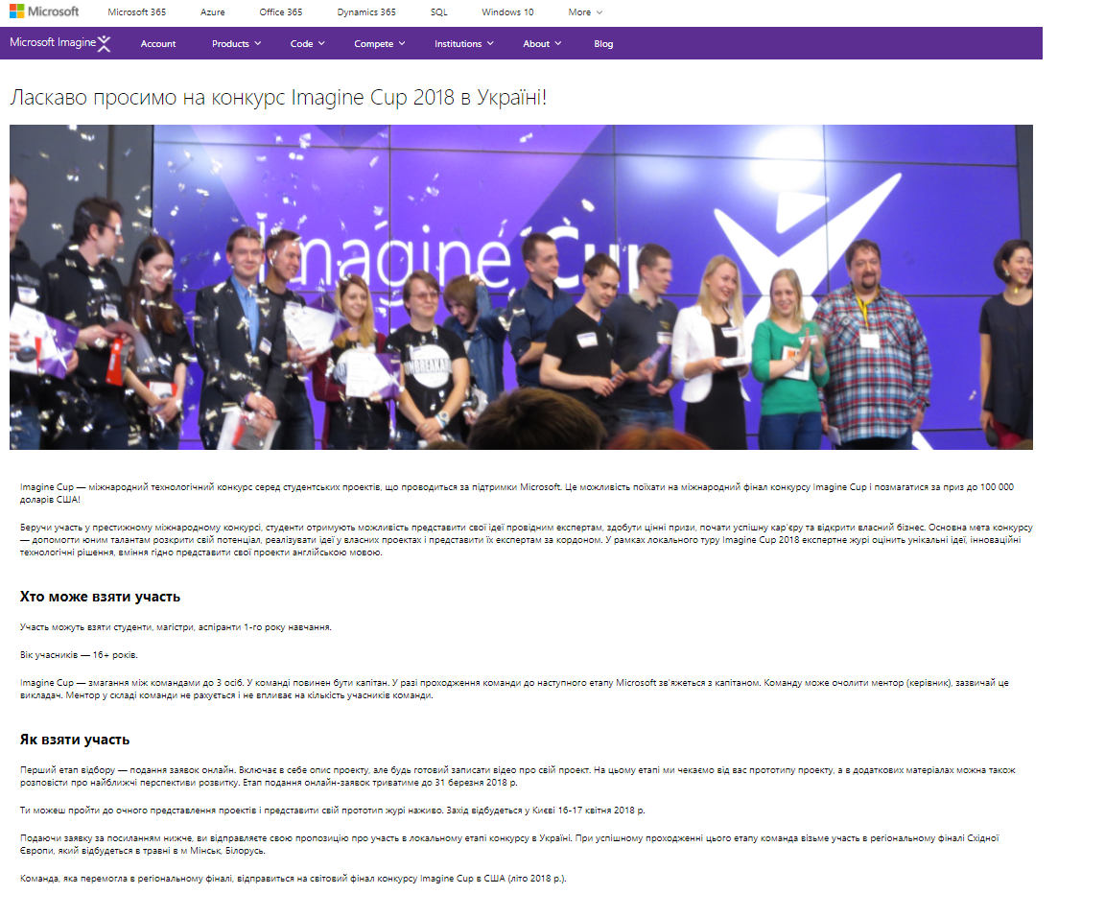
1
2
3
4
Visit Imagine Cup
Website and Register
Edit your info to
create an IC Account
Know your dashboard
and manage IC Team
Join India contest and
Submit your proposal
Go to
https://imagine.microsoft.com/en-us/Country/UA
read more about the competition
and click
Register Now>

Slide 6
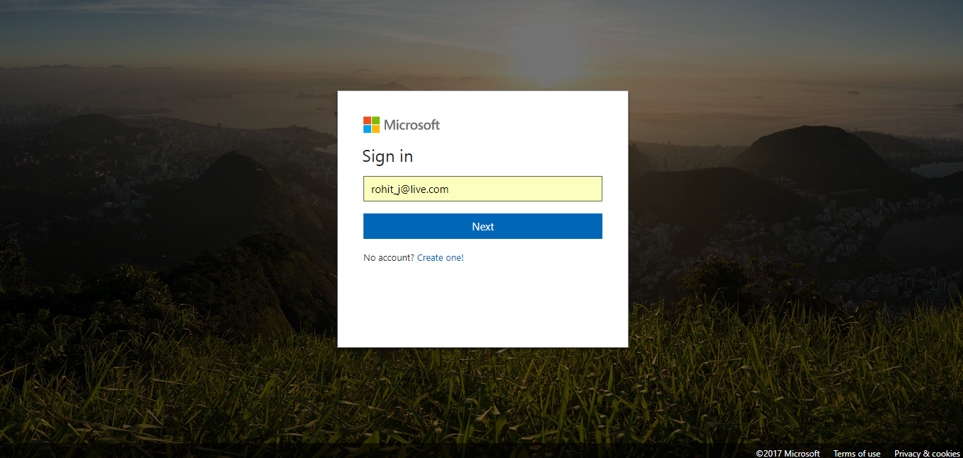
1
2
3
4
Visit Imagine Cup
Website and Register
Edit your info to
create an IC Account
Know your dashboard
and manage IC Team
Join India contest and
Submit your proposal
Sign in
Using your Hotmail or Outlook.com

Slide 7
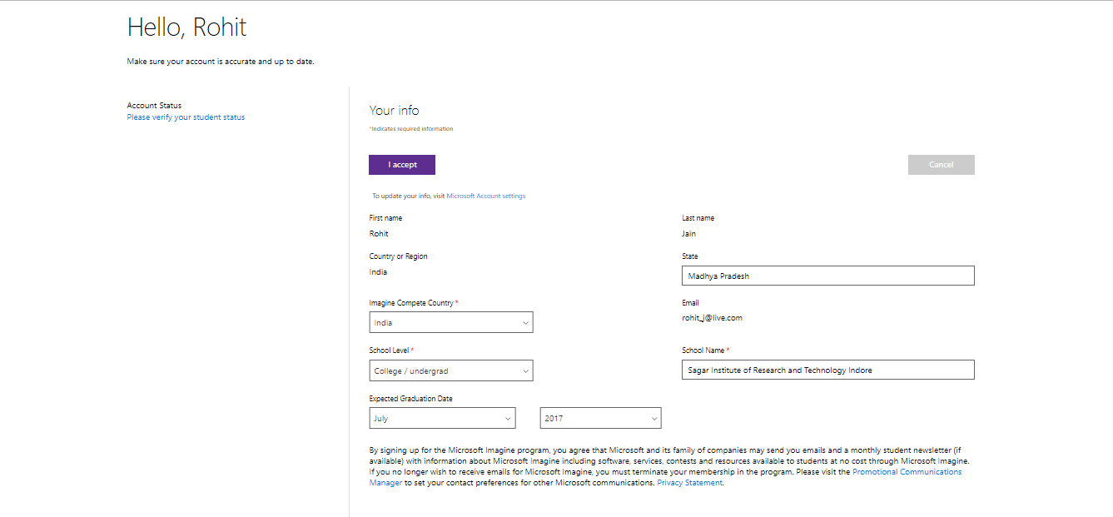
1
2
3
4
Visit Imagine Cup
Website and Register
Edit your info to
create an IC Account
Know your dashboard
and manage IC Team
Join India contest and
Submit your proposal
Create your
Imagine account
Verify Student Status

Slide 8
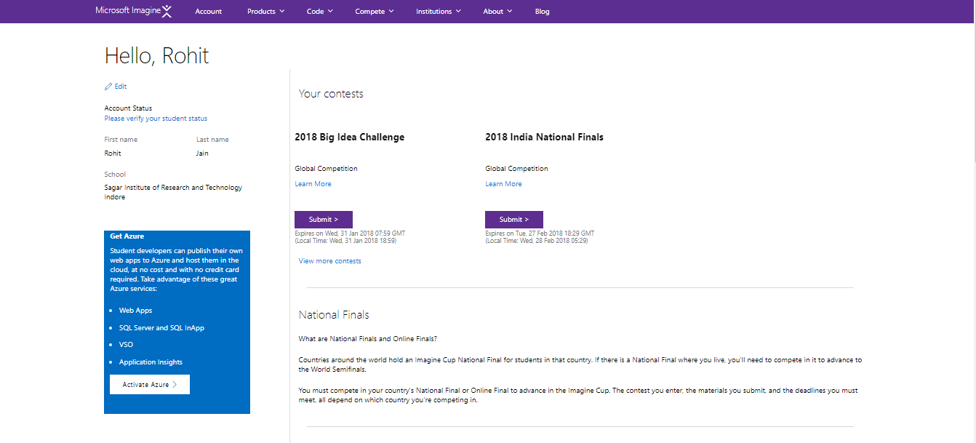
1
2
3
4
Visit Imagine Cup
Website and Register
Edit your info to
create an IC Account
Know your dashboard
and manage IC Team
Join India contest and
Submit your proposal
Once ready,
you will see your
DASHBOARD
Activate Azure

Slide 9
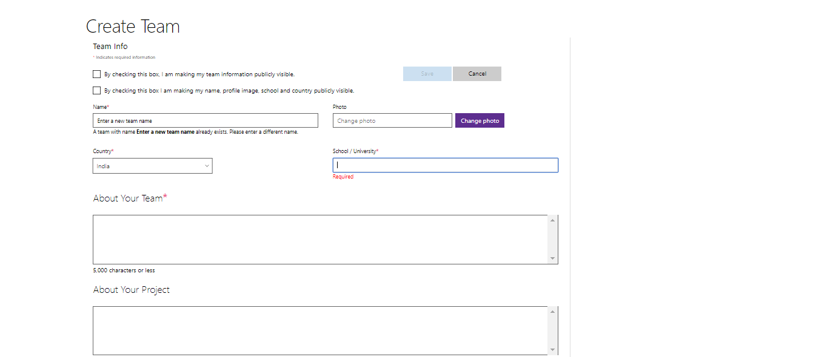
1
2
3
4
Visit Imagine Cup
Website and Register
Edit your info to
create an IC Account
Know your dashboard
and manage IC Team
Join India contest and
Submit your proposal
Create an
Imagine Cup
New Team

Slide 10
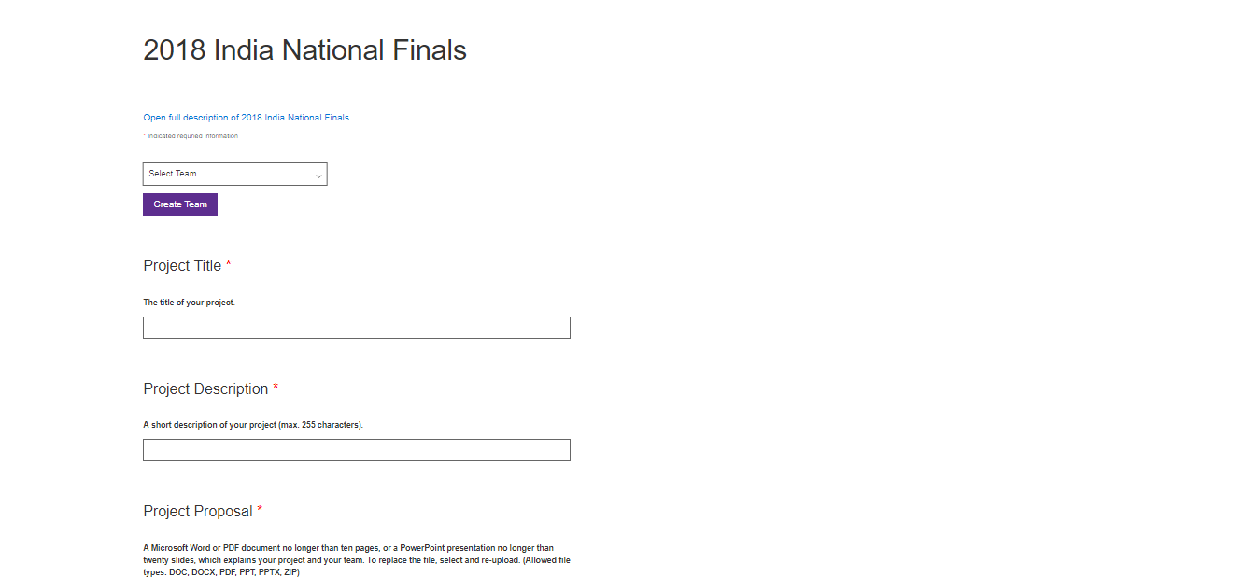
1
2
3
4
Join Eastern Europe
contest and Submit your
proposal
Visit Imagine Cup
Website and Register
Edit your info to
create an IC Account
Know your dashboard
and manage IC Team
Join 2018
India National
Finals
Upload Your
Project Details

Slide 11
What you need to know?
You are at least 16 years of age as of 24 October 2017.
Actively enrolled as a student at an accredited educational institution.
Up to three (3) eligible students may submit a single entry as a team.
Each competitor may belong to only one team within the competition.
To compete, each team member should create an account at https://compete.imagine.microsoft.com/
You must submit a project document, video(max. 3 min),Project plan (ppt or pdf), Primary Azure Technologies
Your project must use one or more of these technologies to be eligible. Artificial Intelligence: Azure AI + Cognitive Services | Big Data: Azure Data + Analytics or IoT | Mixed Reality: HoloLens, VR, or AR.

Slide 12
COMPETITION ROUND DETAILS
Round 0 – Online Project Submission
Project Proposal
Microsoft word/PDF Document lesser than 10 pages/20 slides.
Explains your team.
What your project does?
What platform and features your project uses?
How will you bring it to the market?
Software usable by the judges to evaluate online.
Software must use one of the following formats for its installation depending upon its platform – Windows/Mobile Device/Microsoft Azure

Slide 13
COMPETITION ROUND DETAILS
Round 1 – National Finals
Live Presentation of your project to a panel of judges at the National Final.
Software usable by the judges in a hands-on evaluation.
Software Instructions document explaining how to use your software.

Slide 14
COMPETITION ROUND DETAILS
Round 2- World Finals
Live Presentation of your project to a panel of judges at the World Finals
Software usable by the judges in a hands-on evaluation.

Slide 15
Big Idea Challenge
Pitch your extraordinary idea and your team could win $3,000 USD, and resources to take your idea to the next level!
• $3,000 USD - 1st Place prize • $2,000 USD - 2nd Place prize • $1,000 USD - 3rd Place prize • Judge feedback on project submission – Top 10 teams • $600 in Azure credits – Top 50 teams

Slide 16






Slide 17
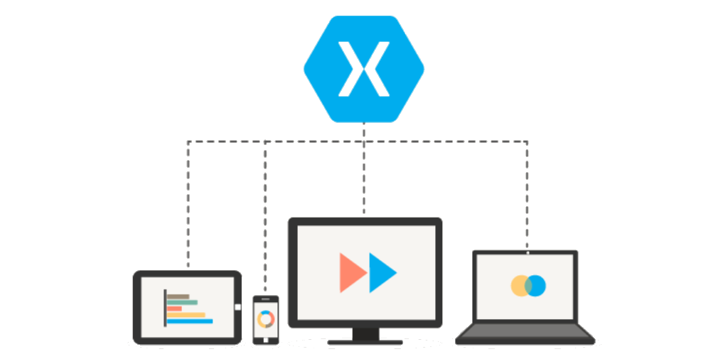
Что такое Xamarin

Slide 18
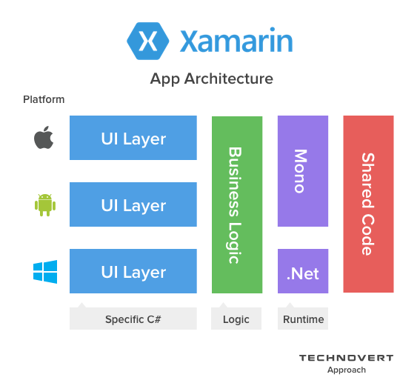
Xamarin - подход

Slide 19
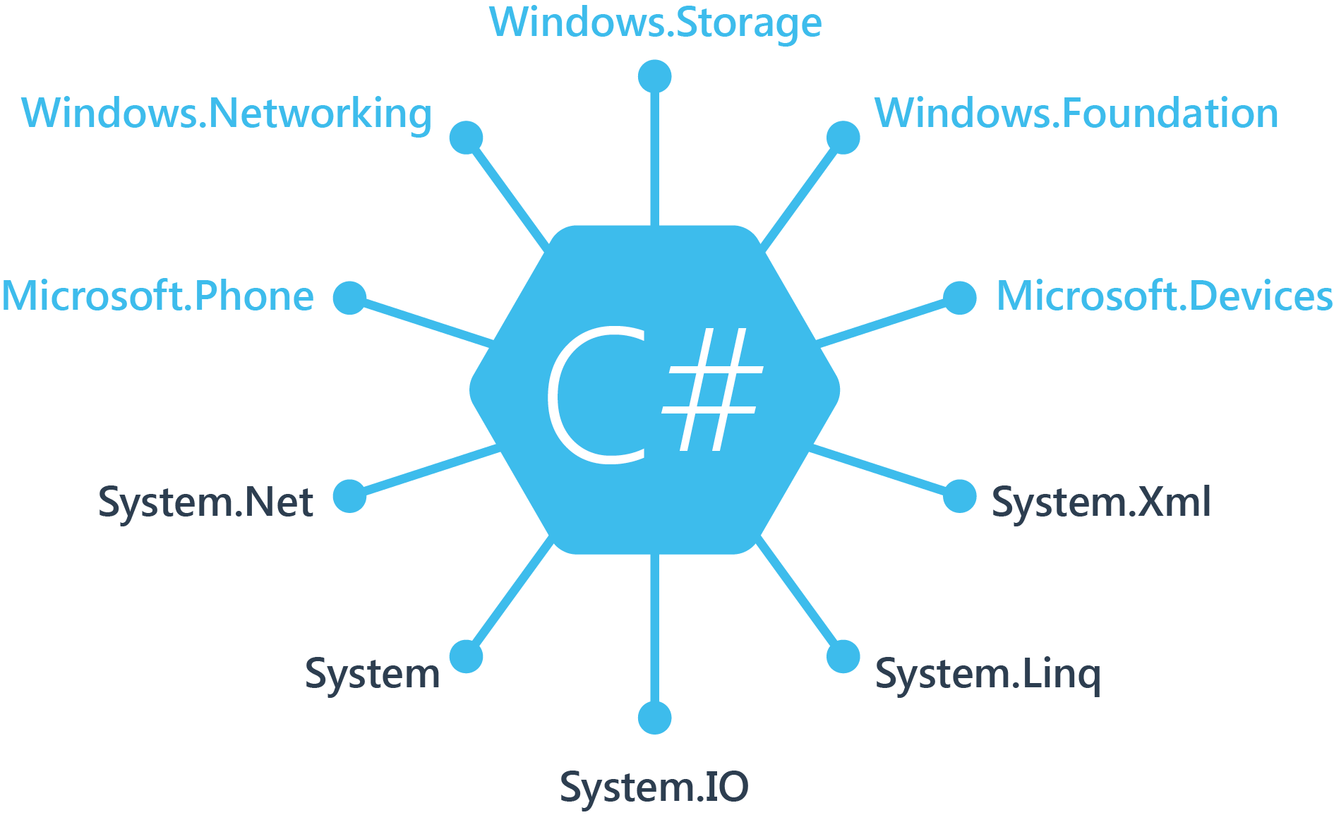
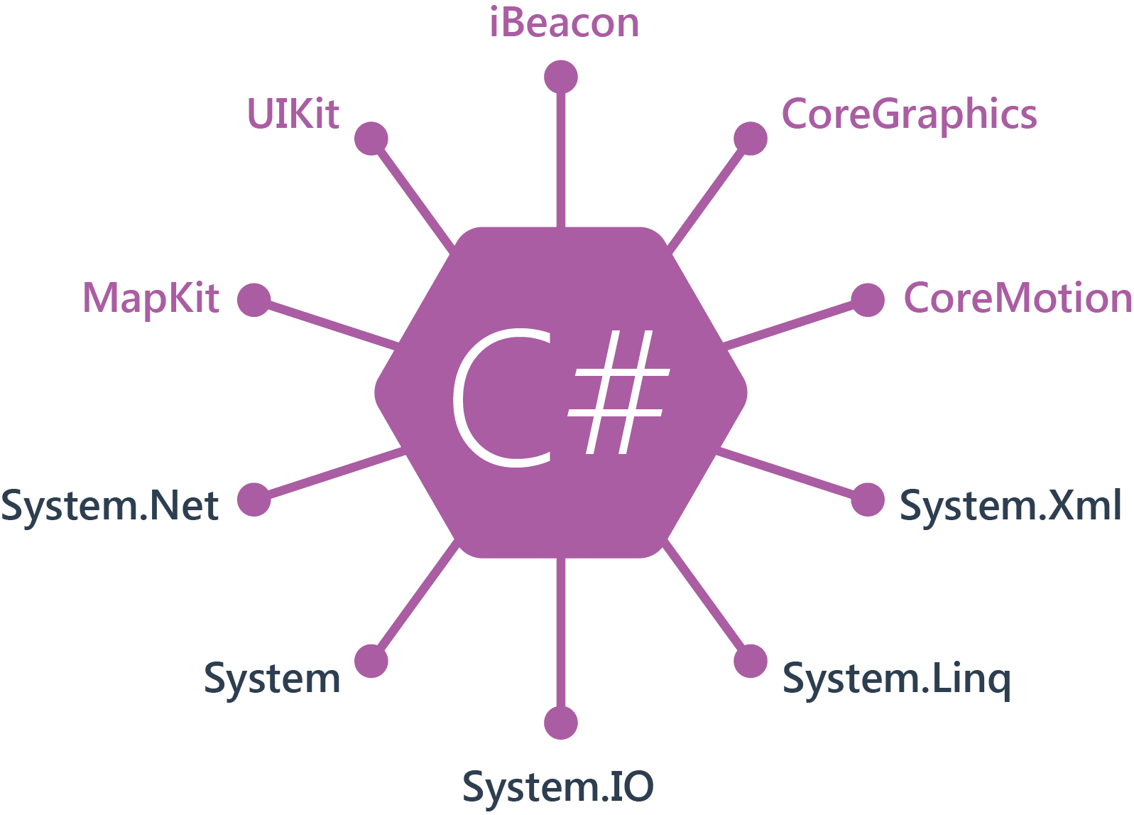
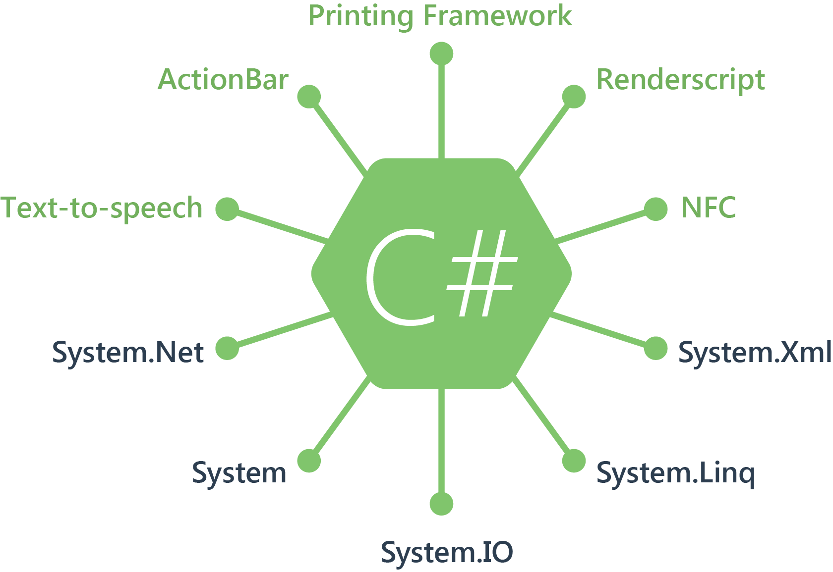
100% покрытие системных API
Windows
iOS
Android
Notes:
Доступ к стандартным c# библиотекам
System.net, system, system.io, system.linq, system.xml
Доступ к специфическим библиотекам для каждой из платформ

Slide 20


Visual Studio everywhere

Slide 21
Thank you!

